Slide 1
Stress IS ASSOCIATED WITH exercise differently among individuals with highER and lowER eating disorder symptoms: An ecological momentary assessment study
Margarita Sala, M.A.¹, Leigh Brosof, B.A. ², David Rosenfield, Ph.D. ¹, Katya C. Fernandez, Ph.D. ³, & Cheri A. Levinson, Ph.D. ²
¹ Department of Psychology, Southern Methodist University, Dallas, TX
² Department of Psychological and Brain Sciences, University of Louisville, Louisville, KY
³ Department of Psychiatry and Behavioral Sciences, Stanford University, Stanford, CA
Notes:
Today I am going to talk about how stress impacts exercise differently among individuals with higher and lower ED symptoms
I would like to thank my co-atuhors

Slide 2
Stress
Stress: the perception that demands exceed an individual’s ability to cope (Lazarus, 1993)
May include major life events and daily hassles (chronic strains on every day life)
Stress is relevant to both exercise and eating disorders (e.g., Berger & Owen Berger Rojo, Conesa, Bermudez, & Liviano, 2006)

Slide 3
Stress and eating disorders
Stress is associated with the development of eating disorders (e.g., Berger & Owen Berger Rojo, Conesa, Bermudez, & Liviano, 2006)
Individuals with eating disorders report experiencing more stressful life events than controls (Raffi, Rondini, Grandi, & Fava, 2000)
Individuals with eating disorders cope with daily stressors by engaging in eating disorder behaviors (Woods, Racine, & Klump, 2010; Wolff, Crosby, Roberts, & Wittrock, 2000)
Notes:
Stress is relevant to eating disorders
Stress is associated with the development of EDs…

Slide 4
Exercise and stress regulation
At least some forms of exercise are associated with reductions in stress in healthy individuals (Berger & Owen, 1988)
It is possible that the relationship between stress and exercise is different in individuals with higher and lower eating disorder symptoms
Notes:
Stress is associated with exercise.. Stress may be a way to regulate ED symptoms
It is possible that the relationship between stress and exercise is different in individuals with higher and lower eating disorder symptoms

Slide 5
Exercise and stress in the context of EDs
Some research suggests that individuals with higher levels of eating disorder symptoms may not exercise when stressed because they view exercise as a way to change their weight and shape rather than as a form of stress-relief (Mond & Calogero, 2009; Bardone-Cone et al. 2016)
Other research suggests that individuals with eating disorders endorse exercising for stress / mood management purposes at higher rates compared to individuals without eating disorders (Bardone-Cone et al., 2016)
Notes:
It is currently unclear whether individuals with eating disorders are more or less likely to exercise when stressed than controls
Some research sugests..
Other research suggests…

Slide 6
Exercise and stress in the context of EDs
Individuals with higher eating disorder symptoms may exercise in a way that makes them more likely to experience increases (rather then decreases) in stress after exercise
Excessively (Davis et al., 1997)
For weight and shape reasons rather than enjoyment (Mond & Calogero, 2009)
Other research suggests that some individuals with eating disorders experience lower negative affect after exercising (Engel et al., 2013; Goldschmidt et al., 2013)
Notes:
Is also unclear whether individuals with eating disorders experience decreases in stress after exercising.

Slide 7
Current Study
Examined the relationship between daily stress and exercise behavior (and vice-versa)
H1: Higher stress would predict more subsequent exercise behavior
H2: Higher exercise behavior would predict less subsequent stress
Tested the moderating effect of eating disorder symptoms on the relationship between: (1) daily stress and later exercise behavior and (2) daily exercise behavior and later stress
H3: In individuals with higher eating disorder symptoms, higher stress would be associated with less later exercise behaviors
H4: In individuals with higher eating disorder symptoms, more exercise would be associated with higher later stress
Notes:
H3: Because individuals with high levels of eating disorder symptoms may exercise to manage their body weight and shape rather than to relieve stress
H4: Because individuals with eating disorders may exercise in a stressful way

Slide 8
Participants
129 female undergraduate students from a Midwestern university
Mean age = 19.19, SD = 1.40
51.2% European American
26.4% Asian
10.1% Multiracial
6.2% Hispanic
5.4% Black

Slide 9
Measures
Eating disorder symptoms
EDI-2 Drive for thinness (Garner, Olmstead, & Polivy, 1983)
EDI-2 Bulimic symptoms (Garner, Olmstead, & Polivy, 1983)
EDI-2 Body dissatisfaction (Garner, Olmstead, & Polivy, 1983)
EMA stress
Stress items from the Depression, Anxiety, and Stress (DASS-21) subscale (Lovibond & Lovibond, 1995)
Finding it hard to wind down, having lots of nervous energy, feeling agitated, finding it difficult to relax, feeling touchy, and feeling stressed
EMA exercise
“How long did you exercise since your last check in?

Slide 10
Procedure
Baseline session in lab
Completed EDI-2
Given instructions on how to use the automated telephone system
Selected 12-hour waking time block
12-hour block was divided into four blocks, and EMA surveys were administered randomly within each of these blocks
EMA protocol
Automated telephone calls four times per day for seven days

Slide 11
Data Analysis
Multilevel modeling (MLM), with one-assessment lag to test for temporal precedence
E.g., exercise at time t was predicted by stress at t-1
Cross-day predictions not included in analysis
Generalized linear mixed model (GLMM; MLM for non-normally distributed outcomes) for analyses in which exercise behavior was the outcome
Assuming negative binomial distribution, log linking function
Because the exercise distribution was skewed with zero minutes of exercise reported at almost half of (46.3%) all assessments
Standard MLM for analyses in which stress was the outcome
Exercise log transformed to reduce skewness
Notes:
Cross-day predictions were not included in the analysis, as it was unlikely that stress at night affected exercise the next day and vice-versa, and preliminary analyses confirmed that there were no cross-day effects (i.e., stress was not associated with exercise behavior the next day nor vice-versa)

Slide 12
Data Analysis
The time varying predictors (TVPs) (i.e., stress, exercise) were disaggregated into the person’s mean across all 28 assessments (TVP_{mean}; the between-person component) and their deviation from their mean at each session (TVP_{deviation;} the within-person component; TVP_{dev} = TVP_{raw} - TVP_{mean})
Reporting limited to TVP_{dev} effects
Notes:
Significant lagged TVP_{dev} effects can be interpreted as reflecting effects of changes in the predictor on the outcome, whereas significant TVP_{mean} effects can be interpreted as between-subjects covariation between the predictors and the outcomes (e.g., people with higher average levels of stress might exercise more/less).
Given that the goal of the study was to make inferences on how stress and exercise are associated with each other within individuals, we limit our reporting to TVP_{dev} effects, although TVP_{mean} effects were included in all analyses (as was necessary to accurately assess the TVP_{dev} effects) (Hamaker et al., 2015).
levels of drive for thinness, bulimic symptoms, body dissatisfaction)(Aiken & West, 1991).

Slide 13
Data Analysis
ED variables treated as continuous moderators
To understand the form of interactions, we plotted the relation between the independent variable and outcome at 3 levels of the moderator: “low” (1 SD below the mean), “average” (at the mean) and “high” levels (1 SD above the mean) (Aiken & West, 1991; Hayes, 2013).

Slide 14
Descriptive Information
2,371 separate EMA recordings
1,759 recordings used after dropping cross-day predictions
Compliance averaged 66% (range 14-96%)
ED symptoms higher than in other college samples
12.4% of women scored in the clinical range on drive for thinness
7.1% on bulimic symptoms
13.3% on body dissatisfaction

Slide 15
Spearman’s rank order correlations
 | M | DT | Bulimia | BD | Stress | Exercise
DT | 21.69 (8.19) | -
Bulimia | 14.25 (5.84) | .60** | -
BD | 31.65 (10.46) | .65** | .44** | -
Stress | 2.05 (0.96) | .24** | .30** | .29** | -
Exercise | 11.59 (13.15) | .08 | .01 | -.14* | .01 | -
DT = Drive for Thinness; BD = Body Dissatisfaction ** p < .01 * p <.05.
Notes:
Eating disorder symptoms were significantly associated with each other
All three eating disorder symptom associated with mean EMA stress
BD negatively associated with exercise

Slide 16
MLM Analyses: Overall Relationships
Stress (b = 0.18, SE = 0.15, p = 0.23) did not predict subsequent exercise behavior
Exercise did not predict subsequent stress (b = -0.01, SE = 0.01, p = 0.30).
Notes:
Surprisignly.

Slide 17
Stress and Later Exercise: Drive for Thinness

Slide 18
Stress and Later Exercise: Drive for Thinness
Drive for thinness moderated the relationship between stress and later exercise (b = -0.033, SE = 0.02, p = 0.047)
Within individuals over time, higher stress just failed to reach significance towards predicting higher later exercise for those who were low in drive for thinness (b = 0.40, SE = 0.21, p = 0.052)
Stress did not predict later exercise in individuals who were average (b = 0.13, SE =0.14, p = 0.34) or high (b = -0.13, SE = 0.18, p = 0.47) in drive for thinness

Slide 19
Stress and Later Exercise: Bulimic Symptoms

Slide 20
Stress and Later Exercise: Bulimic Symptoms
Bulimic symptoms moderated the relationship between stress and later exercise (b = -0.06, SE = 0.03, p = 0.017)
Within individuals over time, higher stress predicted higher later exercise for those who were low in bulimic symptoms (b = 0.54, SE = 0.22, p = 0.016)
Stress did not predict later exercise in individuals who were average (b = 0.19, SE = 0.15, p = 0.19) or high (b = -0.15, SE = 0.19, p = 0.42) in bulimic symptoms

Slide 21
Stress and Later Exercise: Body Dissatisfaction

Slide 22
Stress and Later Exercise: Body Dissatisfaction
Body dissatisfaction moderated the relationship between stress and later exercise (b = -0.05, SE = 0.01, p = 0.001)
Within individuals over time, higher stress predicted higher later exercise for those who were low in body dissatisfaction (b = 0.65, SE = 0.20, p = 0.001)
Stress did not predict later exercise in individuals who were average (b = 0.16, SE = 0.14, p = 0.25) or high (b = -0.33, SE = 0.18 p = .08) in body dissatisfaction.

Slide 23
Exercise and Later Stress
Drive for thinness (b = 0.00, SE = 0.00, p = 0.68), bulimic symptoms (b =0.00, SE = 0.00, p = 0.09), and body dissatisfaction (b = 0.00, SE = 0.00, p = 0.78) did not moderate the relationship between exercise and later stress.

Slide 24
Conclusion
Eating disorder symptoms significantly moderate the relationship between daily stress and later exercise
Only individuals who were lower in eating disorder symptoms were likely to exercise when stressed
Did not find any evidence that eating disorder symptoms moderate the relationship between exercise behavior and later stress

Slide 25
Conclusion
Individuals who are higher in ED symptoms might not exercise when stressed because they may exercise for reasons other than stress management
E.g., weight management, habit
Exercise is not associated with decreases in stress immediately
But may decrease stress in the long-term (e.g., Salmon, 2001)

Slide 26
Clinical Implications
Psychoeducation regarding the anxyliotic properties of exercise to encourage individuals with higher ED symptoms to respond to stress by engaging in therapeutic exercise rather than other maladaptive behaviors they may be currently engaging
See Cook et al. (2016) for guidelines for the use of exercise in treating eating disorders
Psychoeducation should emphasize that exercise may not decrease stress immediately, but may do so in the long-term
Target reasons for exercise
Notes:
Target reasons for exercise - For example, they may be encouraged to focus on stress management as a reason for exercise rather than exercising to control weight and shape.

Slide 27
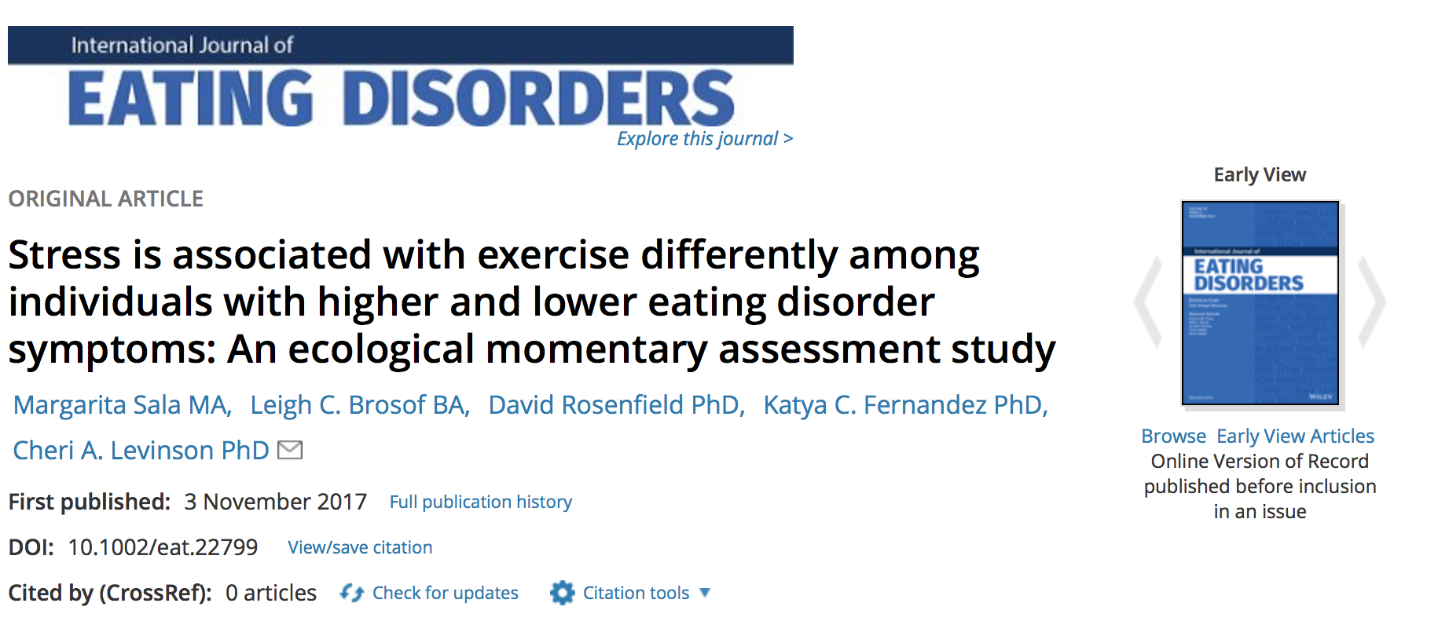
Further Reading

Slide 28
Acknowledgments
This research was funded by F31-MH096433 and an APA Dissertation Award to Cheri A. Levinson.
Margarita Sala is supported by the National Science Foundation Graduate Research Fellowship under Grant No. DGE-1356109.

