Slide 1
The Relationship Between Eating Disorder Cognitions and Behaviors: Using Intra-individual Network Analysis To Identify Personalized Intervention Targets
Cheri A. Levinson, Ph.D.
Irina Vanzhula, B.A.
Benjamin Calebs, B.A.
University of Louisville
Department of Psychological & Brain Sciences

Slide 2
Heterogeneity in Eating Disorders
Traditionally, EDs characterized as distinct categorical disorders
Anorexia nervosa (AN)
Bulimia nervosa (BN)
Binge eating disorder (BED)
Other specified feeding and eating disorders (OSFED)
There is significant heterogeneity in the eating disorders
Most fall into OSFED category
No baseline predictors of outcomes (besides duration of illness and age of onset)
Some recover – some do not
Why?
Dalle 2010; Keel & Brown, 2011

Slide 3
Cognitive-Behavioral Model
Primary theory is cognitive-behavioral
CBT-E
Current treatment is “one size fits all”
But extreme heterogeneity….
Fairburn, Cooper, and Shafran, (2003)

Slide 4
Personalized Treatments
Precision medicine initiative suggests that identifying more precise targets will lead to more effective treatment
Data from anxiety and depression literature show that data-driven methods outperform clinician judgment
We need individualized, data-driven methods to assist clinicians with the identification of which symptoms to address in treatment
But how?
Insel, 2014; Fernandez et al., 2017; Fisher et al., 2017

Slide 5
Network Analysis
Assumes that psychopathology arises from causal connections between symptoms
Moves away from underlying latent variable model
Allows for characterization of:
Core symptoms
Illness pathways
Clinical relevance
Identify core symptoms to target in treatment
Identify pathways between symptoms-what maintains psychopathology?
CAN BE USED TO DEVELOP INDIVIDUAL NETWORKS!
Which can be used to personalize treatment!
Cramer et al., 2010; McNally et al, 2017

Slide 6
Current Study
Overall Aim: Identify maintaining symptoms within and between individuals to inform future treatment development
Goal 1: Explore temporal relationship between cognitions and behaviors in individuals with EDs
Need average to understand differences
Goal 2: Explore individual differences in symptom interactions by comparing intraindividual networks of three participants all with AN

Slide 7
Participants
N = 66 patients with eating disorders
Most participants are female (n = 64; 97%)
Most participants are European American (n = 56; 84.8%)
Average age is 24.98 (SD = 7.31)
Most participants primary diagnosis is AN (n = 54; 81.8%)
Most have comorbid anxiety (n = 41;62.1%) or depression (n = 38; 57.6%)
Most are currently in treatment (n = 49; 74.2%)
On average 7.32 hours a week of treatment

Slide 8
Procedure
Participants recruited from intensive treatment center
All participants have diagnosis of an eating disorder
Based on treatment team diagnosis, as well as Eating Disorder Diagnostic Inventory
Use status-post iphone application for one week
4 times a day (28 measurement points)
Assess real-time cognitions and behaviors

Slide 9
Measures: Cognitions
Selected items from Eating Disorder Inventory-2 (EDI-2)
Participants were asked to rate how they felt “right now”
Rated each item on a 1 to 6 scale where 1 = not at all and 6 = extremely
I feel like I have overeaten
I am thinking about dieting
I am preoccupied with the desire to be thinner
I am terrified of gaining weight
Garner, Olmstead, & Polivy, 1983

Slide 10
Measures: Behaviors
Asked to rate how much they engaged in the following behaviors since last check in: 1 (not at all) to 6 (a lot)
Vomiting or other compensatory behaviors
Excessive exercise
Body-checking
I have weighed myself
Binge-eating
Restriction

Slide 11
Data Analytic Procedures
We created temporal, contemporaneous, and between-subject models based on the sample N = 66
We estimated these models using the two-step multi-level VAR: the mlVAR package for R
Temporal: one variable predicts another at the next window of measurement
Contemporaneous: estimates relationships at the same time point after controlling for temporal effects
Between-subject: between-subject prediction of the mean of one variable given the means of other variables
Bringmann et al., 2013; Epskamp et al., 2012; Epskamp, Waldorp, & Mottus, 2016

Slide 12
Data Analytic Procedures: Individual Networks
We created temporal and contemporaneous networks for 3 individuals each with AN
We estimated the networks using the graphicalVAR package for R
Wild, et al., 2010; Epskamp et al., 2012; Epskamp, et al., in press

Slide 13
Data Analytic Procedures
Centrality was calculated using the centralityPlot and centralityTable functions in qgraph.
Strength (Degree) - sum of all absolute edge weights of edges connected to a given node
InDegree – sum of connections pointing towards the focal symptom
indicates how many incoming arrows a symptom receives from the directly connected symptom
OutDegree – sum of connections pointing from the focal symptom to other symptoms
indicates how many outgoing arrows or how much information a symptom sends to other symptoms it is directly connected to
Fried et al., 2017; Opsahl, Agneessens, & Skvoretz, 2010

Slide 14
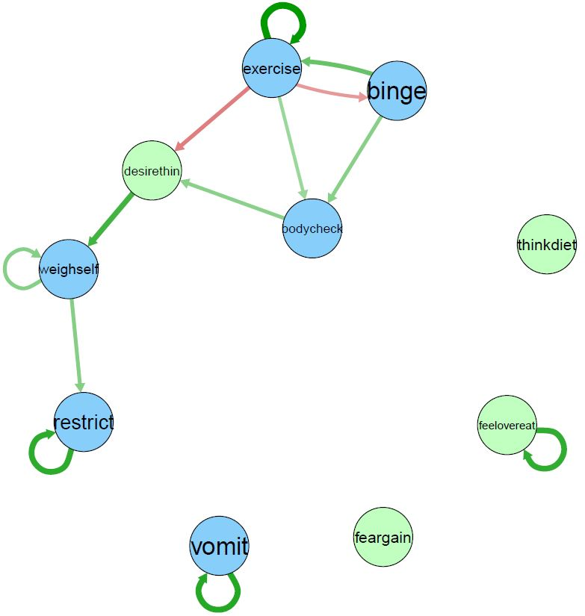
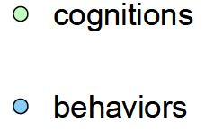
.22
Figure 1. Temporal network
.13
-.11
-.09
.09
.10
.10
.16
.10
.10
.18
.18
.18
Note: Edges that were not significantly different from zero were removed from the networks.

Slide 15
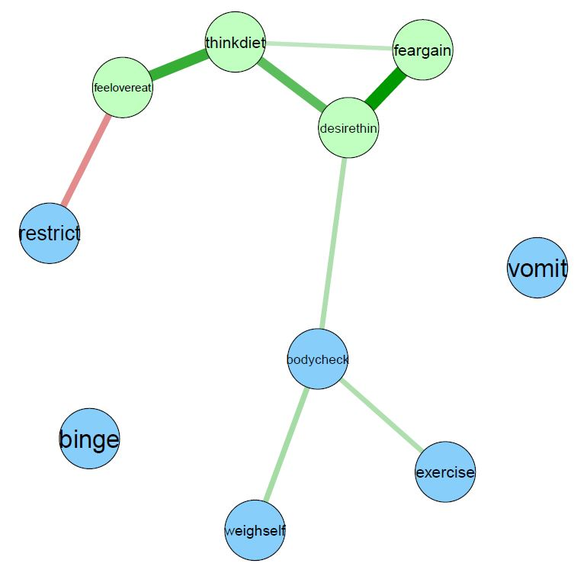
Figure 2. Contemporaneous network
.12
.36
.30
.46
-.21
.15
.14
.16
Note: Edges that were not significantly different from zero were removed from the networks.

Slide 16
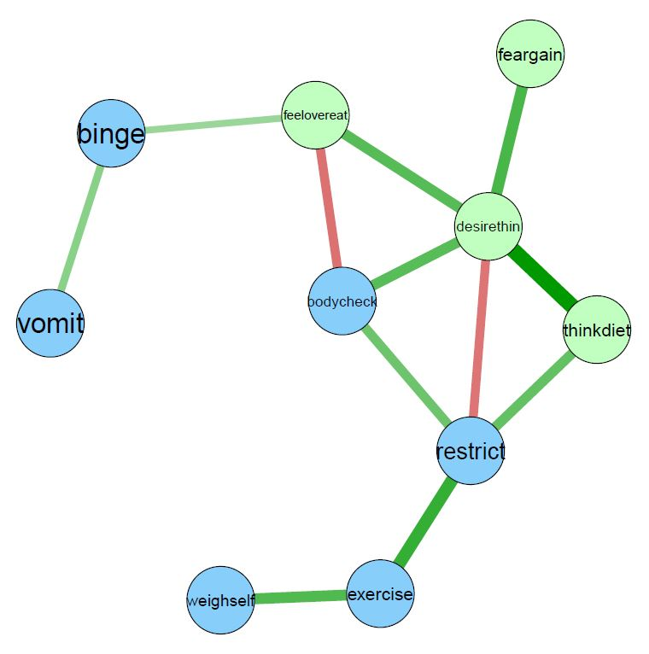
Figure 3. Between-subjects network
.22
.37
.40
-.31
.26
.37
.56
-.30
.32
.34
.45
.39
Note: Edges that were not significantly different from zero were removed from the networks.

Slide 17
Results
Symptoms with highest centrality (strength)
Temporal network:
Desire to be thin (inStrength = 1.45)
Body checking (InStrength = 1.18)
Exercise (OutStrength = 1.82)
Binge eating (OutStrength = 1.33)
Contemporaneous network:
Desire to be thin (Strength = 1.62)
Thinking about dieting (Strength = 1.23)
Fear of weight gain (Strength = 0.61)
Between-Subjects network:
Desire to be thin (Strength = 2.13)
Restriction (Strength = 1.04)

Slide 18
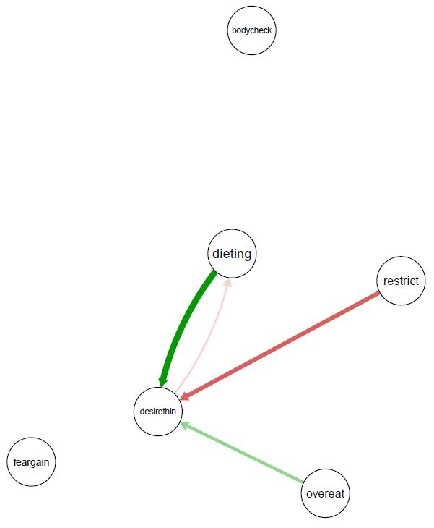
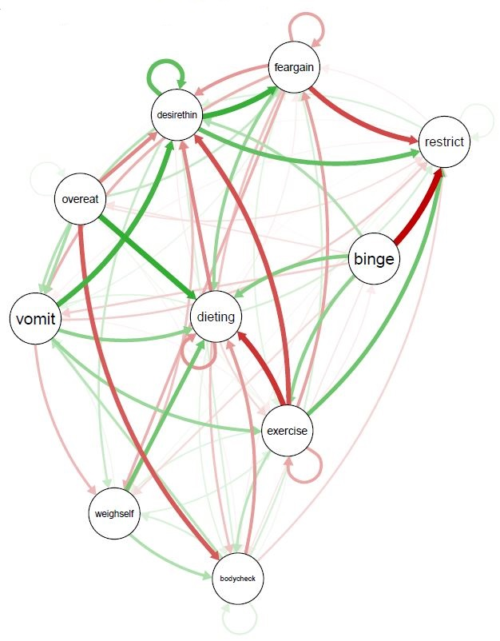
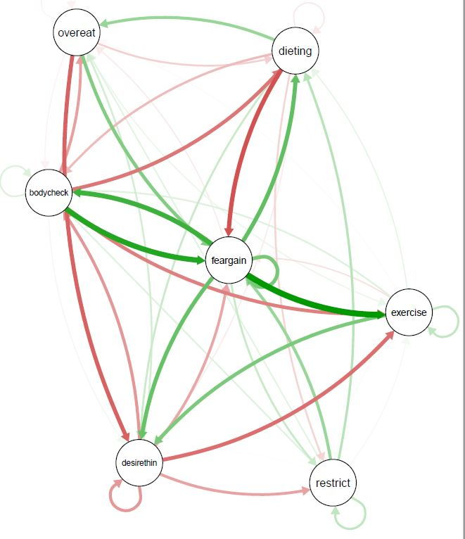
Results
Temporal networks for 3 individuals each with AN
Person 1
Person 2
Person 3

Slide 19
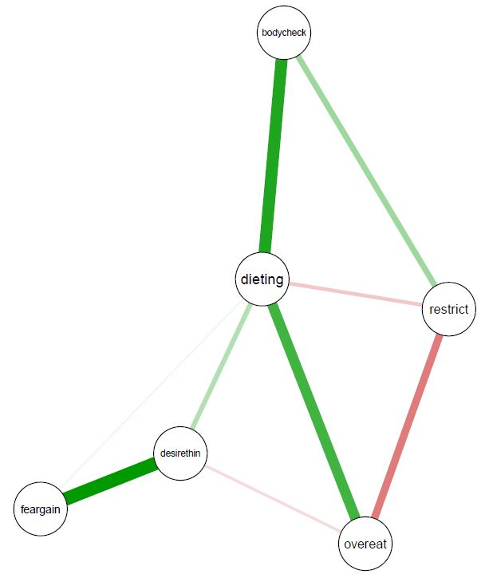
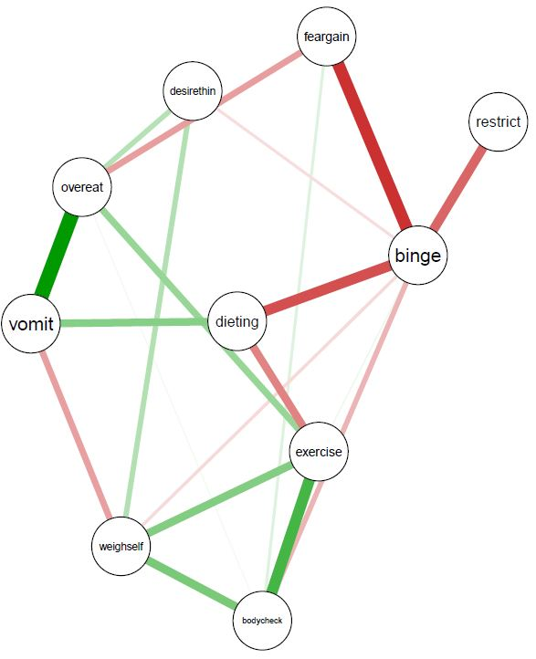
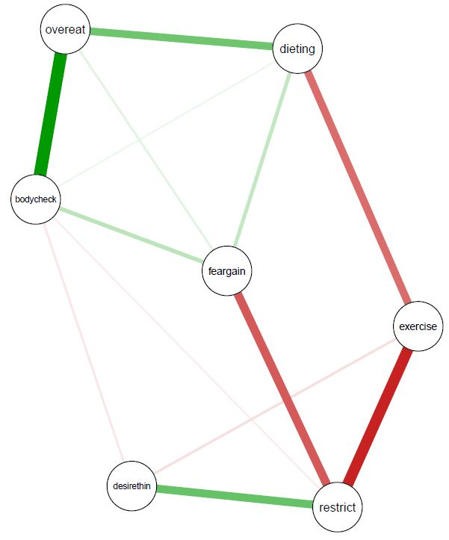
Results
Contemporaneous networks for 3 individuals each with AN
Person 1
Person 2
Person 3
Think about dieting (Strength = 1.90)
Binge (Strength = 1.61)
Exercise (Strength = 0.78)
Restrict (Strength = 1.67)
Think about overeating (Strength = 0.44)

Slide 20
Overall Conclusions
Results are tentative!
Not enough data points
All three networks
Desire to be thin was most central
Cognitions overall are more central
Levinson et al. (2017). Journal of Abnormal Psychology

Slide 21
Temporal network
Over ~4 hours
Desire to be thin is essential part of the chain of behaviors in temporal network
Other cognitions (fear of weight gain, thinking about dieting, fear of over-eating) are not driving behaviors

Slide 22
Contemporaneous network
Binge eating and vomiting are on the periphery
Cognitions grouped together
Is desire to be thin ‘surface cognition’ driving behaviors
Do other cognitions stem from desire to be thin?
Behaviors grouped together

Slide 23
Between-subjects network
Desire for thinness, fear of weight gain, thinking about dieting very strongly correlated
Cascade effect?

Slide 24
Individual networks
Eating disorders are heterogeneous!
Person 1: thinking about dieting
Challenge thoughts
Person 2: binge eating; exercise
Change behaviors
Person 3: Restrict; thinking about overeating
Disrupt connection between thought & behavior

Slide 25
Limitations
Not enough assessment points!!
Small sample
What cognitions and behaviors should we include?

Slide 26
Clinical Implications
Eating disorders are heterogenous!
Need to personalize existing treatments using data
Modular treatments
What is the structure of eating disorders both between and within persons?
Inform interventions

Slide 27
Future Directions
Large scale data collection with intensive longitudinal data
100+ assessment points with 400 individuals
Include physiological data
Use machine learning to create algorithm that directly informs clinician and patients of which symptom/s to target and which treatment to use

Slide 28
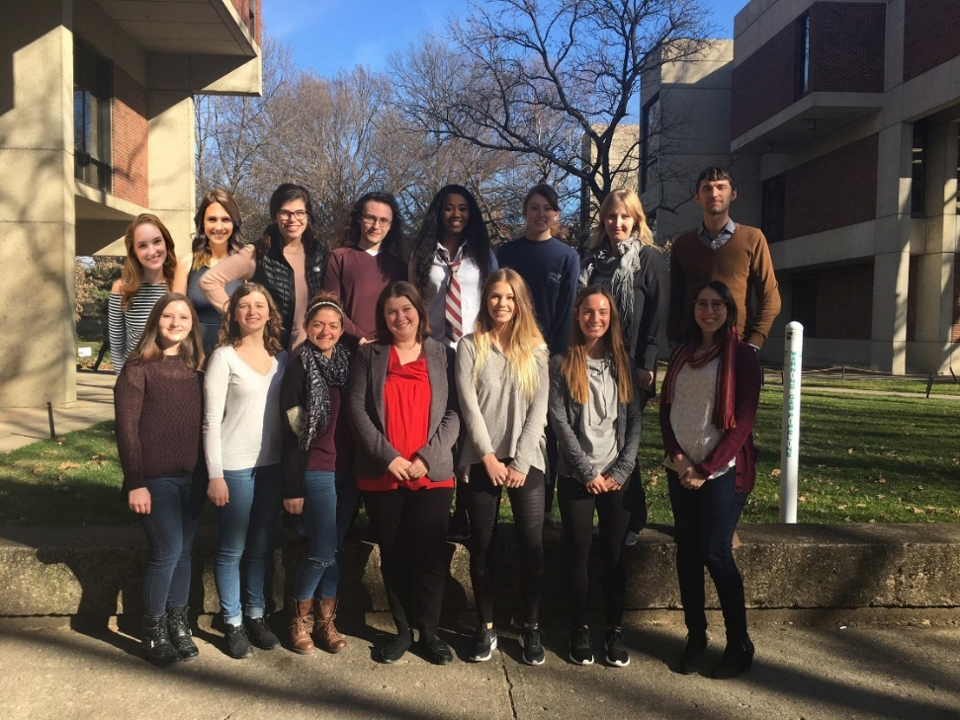
QUESTIONS?
Contact: Cheri A. Levinson
Assistant Professor
Director, Eating Anxiety Treatment Lab
Clinical Director, Louisville Center for Eating Disorders
cheri.levinson@louisville.edu
502-852-7710
www.louisvilleeatlab.com
www.louisvillecenterforeatingdisorders.com
Clinical Treatment & Research Opportunities for Individuals with Eating Disorders are Available!

